Slide 1
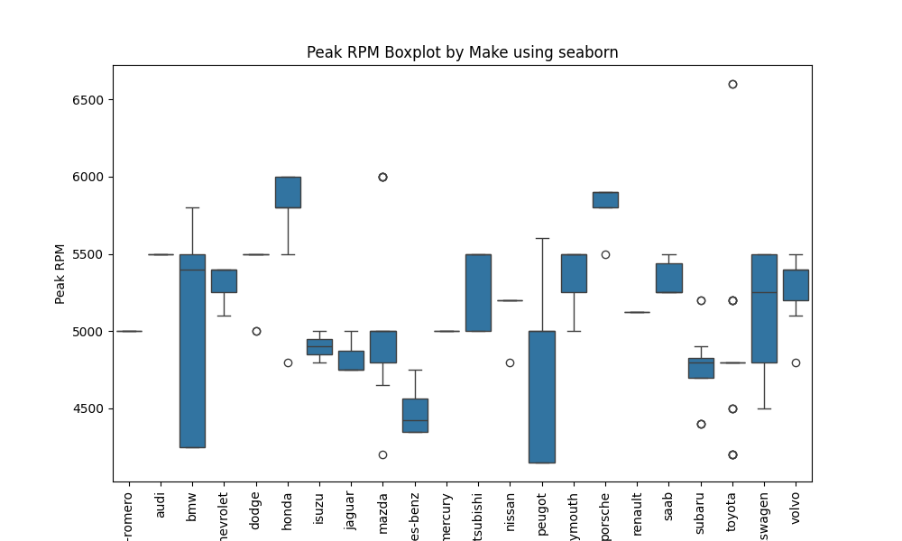
Peak RPM Boxplot by Make #1

Slide 2
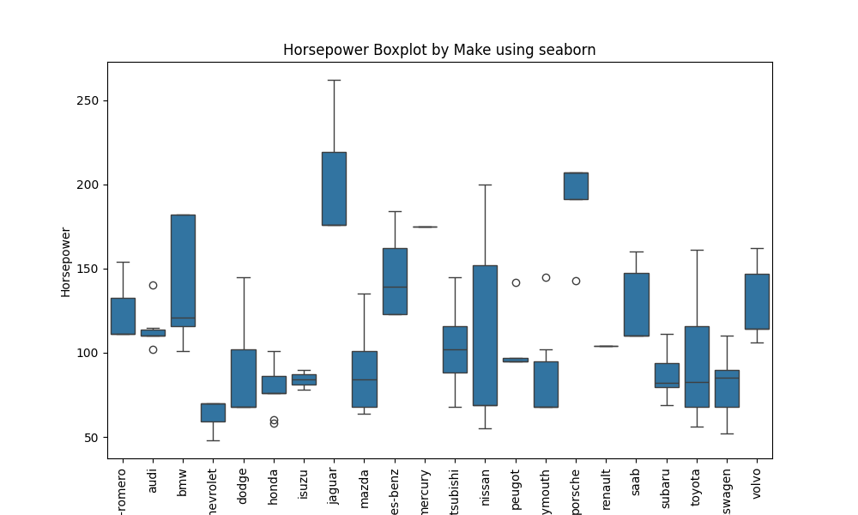
Horsepower Boxplot by Make #2

Slide 3
Horsepower Boxplot by Make #3

Slide 4
Horsepower Boxplot by Make #4

